Slide 1

VEHICLE ROUTING PROBLEM WITH SIMULTANEOUS PICKUP & DELIVERY
Submitted By -
Harshini Borugadda
23MCMI13
Guided By -
Dr. Naveen Nekuri
Assistant Professor, UOH

Slide 2
Contents
Problem Statement
Introduction
Applications
Literature Review
Solution Approach
FILO Framework
FSPD Framework
References

Slide 3
Problem Statement
Develop an efficient heuristic (FSPD) to solve large-scale VRPSPD and VRPMPD instances, ensuring computational efficiency and high solution quality.
The problem is modeled on a graph with vertices (depot and customers) and edges (with associated costs).
Graph Components:
G = (V, E): The problem is represented on an undirected graph G.
Vertices (V): Includes a depot (0) and a set of customers (Vc).
Edges (E): Connections between vertices with an associated cost (cij).
Customer Demands:
Delivery Demand (di): The amount each customer needs to receive from the depot.
Pickup Demand (pi): The amount each customer sends back to the depot.
Depot Demands: Both delivery and pickup demands for the depot (d0 and p0) are zero.

Slide 4
Problem Statement
Vehicle Fleet:
Homogeneous Vehicles: Vehicles have the same capacity (Q).
Fleet Size: Can be unlimited or fixed, depending on the problem setting.
Routes - Feasibility Conditions:
Each customer is visited by one vehicle.
Each vehicle travels only one route.
Routes start and end at the depot.
Pickup demands for each route do not exceed vehicle capacity (Q).
Vehicle capacity constraints are met after each customer visit to avoid overloading.

Slide 5
Introduction
E-commerce and environmental concerns have created new transportation and logistics challenges. Management of forward and reverse logistics is a pressing issue.
Growing volume of returns from online shopping impacts businesses' bottom lines and environment. Carbon footprint and potential for increased landfill waste necessitate efficient routing strategies. Vehicle Routing Problem (VRP) is a key concept in logistics optimization.
A research study focused on developing an algorithm for two specific types of Capacitated Vehicle Routing Problem (CVRP): the Vehicle Routing Problem with Simultaneous Pickup and Delivery (VRPSPD) and the Vehicle Routing Problem with Mixed Pickup and Delivery (VRPMPD). These problems are common in logistics where vehicles must handle both pickups and deliveries efficiently.
To extend an existing algorithm framework (FILO) designed for the basic CVRP to handle VRPSPD and VRPMPD.
To ensure the new algorithm (called FSPD) is competitive with the best existing algorithms.
To efficiently solve large benchmark problems, ensuring the computing time increases linearly with problem size.

Slide 6
Applications
Impact of the Gig Economy:
Increased waste and returned goods due to online shopping.
High return rates during the holiday season and for online purchases.
Disaster Management:
Efficiently allocate limited resources and aid during crises.
Ensure timely delivery of essential supplies to affected areas.
Environmental Concerns:
Returns contribute significantly to carbon emissions and landfill waste.
Efficient management of returns is essential for environmental benefits.
Reverse Logistics:
Focus on operational problems related to routes where pickups and deliveries can occur simultaneously.
Importance of optimizing vehicle usage to reduce environmental impact.

Slide 7
Literature Review
The Vehicle Routing Problem with Simultaneous Pickup and Delivery (VRPSPD) has garnered significant attention due to its practical relevance for distribution companies. The problem was first introduced by Min (1989), who developed a model and heuristic method based on a "Cluster First - Route Second" approach, applied to a public library distribution system. Since then, numerous studies have focused on VRPSPD and its variants.
A comprehensive survey by Koç et al. (2020) provides a detailed review of heuristics developed for VRPSPD, categorizing 29 relevant papers into the following heuristic types:
Classical Construction and Improvement Heuristics: 3 papers.
Local Search Metaheuristics: 15 papers.
Population Search Heuristics: 6 papers.
Ant Colony Heuristics: 5 papers.

Slide 8
Literature Review
Performance Measuring Datasets:
Salhi and Nagy (1999): 28 instances with 50-199 customers divided into two subsets (CMTX and CMTY).
Dethloff (2001): 40 instances with 50 customers each, featuring different customer distributions.
Montané and Galvão (2006): 18 instances with 100, 200, and 400 customers, derived from VRP with time windows test problems.
Key Contributions and Developments:
Subramanian et al. (2013) and Vidal et al. (2014): Identified as providing best solutions in Koç et al. (2020) survey.
Simsir and Ekmekci (2019): Proposed artificial bee colony algorithm tested on Dethloff (2001) instances.
Hof and Schneider (2019): Developed adaptive large neighborhood search combined with path-relinking (ALNS-PR), tested on Salhi and Nagy, Dethloff, and Montané and Galvão datasets.

Slide 9
Literature Review
Other Metaheuristics :
Christiaens and Vanden Berghe (2020) introduced the SIR heuristic, which achieved BKS in 22 out of 28 instances of Salhi and Nagy (1999).
Hornstra et al. (2020) proposed an adaptive ALNS metaheuristic strengthened by a local search procedure, finding 11 BKSs out of 14 instances for the first dataset.
Hamzadayı et al. (2020) developed the Single Seekers Society (SSS) algorithm, combining various local search heuristics, reaching almost all BKSs.
Olgun et al. (2021) designed a hyper-heuristic (HH-ILS) algorithm for the green version of VRPSPD, achieving 38 BKSs out of 40 instances.
Park et al. (2021) proposed a genetic algorithm, but did not use standard test problems for comparison.
Öztaş and Tuş (2022) presented a hybrid metaheuristic combining iterated local search, variable neighborhood descent, and threshold acceptance metaheuristics, performing competitively on Salhi and Nagy (1999) and Dethloff (2001) datasets.

Slide 10
Literature Review
The Fast ILS Localized Optimization for Simultaneous Pickup and Delivery (FSPD) algorithm is designed to solve Vehicle Routing Problems with Simultaneous Pickup and Delivery (VRPSPD) and Vehicle Routing Problems with Multiple Pickup and Delivery (VRPMPD).
FSPD is an extension of the FILO framework tailored for the Capacitated Vehicle Routing Problem (CVRP) by Accorsi and Vigo (2021) but adapted to more constrained VRP variants.
It includes new features to enhance performance on constrained VRP variants.
The FSPD approach can be extended to other VRP variants as long as constraints can be expressed in terms of Route Exchange Formats (REFs) for efficient handling within local search.
Extensions of FSPD to different VRP variants may require design changes to optimize effectiveness.
The paper provides a brief overview of the FILO framework and then details the extensions made in FSPD to accommodate pickup and delivery constraints for VRPSPD and VRPMPD.

Slide 11
Solution Approach : FILO Framework
The FILO algorithm is a randomized and efficient algorithm specifically designed for the effective solution of large-scale instances of the Capacitated Vehicle Routing Problem (CVRP).
The algorithm initializes a random engine with a seed for each run and creates an initial solution using a restricted version of the Clarke and Wright savings algorithm.
It may apply a route minimization procedure if the initial solution has more routes than a greedily estimated number.
The core of the optimization iteration is based on the iterated local search (ILS) paradigm. It consists of a shaking step and a local search step interleaving for a fixed number of iterations.
After applying local search, the resulting solution is accepted with a probabilistic rule based on simulated annealing.

Slide 12
Solution Approach : FILO Framework
The efficiency of FILO is due to the locality of its procedures, where both shaking and local search make changes in a spatially delimited area of the solution.
The shaking procedure achieves locality by removing spatially close customers in a ruin-and-recreate manner, while the local search maintains locality through a heuristic pruning technique called selective vertex caching (SVC).
SVC tracks a limited-size set of recently modified solution areas. This ensures that the algorithm's computational effort in each core optimization iteration is almost independent of the instance size.
Although the algorithm includes some linear-time operations like solution copying, these have a limited impact on the overall computing time of an iteration.

Slide 13
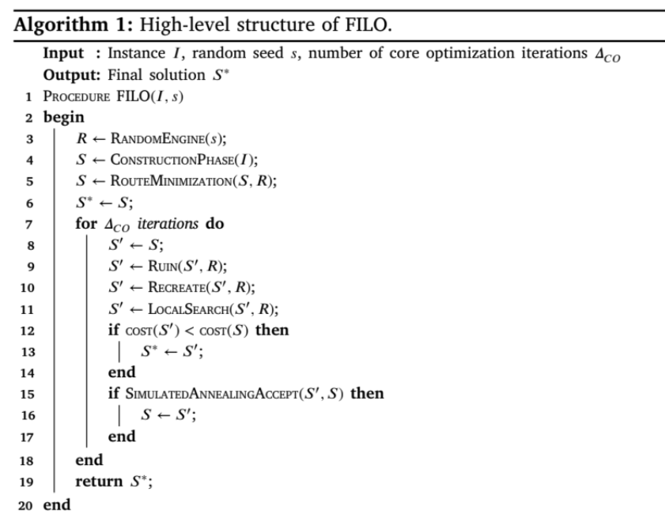
Solution Approach : FILO Framework
Components of Core Optimization Iteration
Ruin and Recreate:
The ruin-and-recreate procedure disrupts the current solution by removing a subset of customers that are spatially close.
This step is crucial for introducing diversity and escaping local optima.
Local Search:
The local search step aims to improve the solution by exploring the neighborhood of the current solution.
The search is focused on areas that have been recently modified, using the selective vertex caching (SVC) technique.
Src: https://doi.org/10.1016/j.tre.2024.103550

Slide 14
Solution Approach : FILO Framework
Shaking: Generates a new solution from the current solution.
1. Ruin step
Random seed
Removal of customer
Random walk
2. Recreate Step
Reinsertion of Customers:
Equal Probability
Local Search: Refines the solution obtained from the shaking step to find a local optimum.
Vertex-wise Granular Neighborhoods (GNs):
Move Generators
Selective Vertex Caching (SVC):
Tracking Changes
Heuristic Pruning
Static Move Descriptors (SMDs):
Move Identification
Data Structures

Slide 15
Solution Approach : FSPD Framework
The extension of the FILO framework to more constrained VRPs requires a substantial effort to incorporate the handling of problem-specific constraints while retaining the efficiency and scalability of the main procedures. In FSDP, this is achieved by mainly extending three components of the algorithm, namely:
the initial solution construction
the shaking step
the local search engine
Introduction of two major innovations in the original FILO approach, namely:
an extension of the local search engine to support the well-known resource extension functions (REFs)
a generalization of the original recreate strategy aimed at handling multi-attribute VRPs.

Slide 16
Solution Approach : FSPD Framework
Resource Extension Functions (REFs)
REFs extend algorithms from the Capacitated Vehicle Routing Problem (CVRP) to more complex VRP variants.
These variants often have additional constraints that cannot be efficiently managed by simple cumulative attributes.
For basic CVRP, capacity, and distance constraints are managed using demand-sum and distance-sum respectively.
For complex VRP variants like VRPSPD and VRPMPD, simple cumulative attributes are insufficient due to the non-monotonical load profile and propagating local infeasibilities.
General approaches include Lexicographic Search, Global Variables, and Segment REFs.

Slide 17
Solution Approach : FSPD Framework
Extending Local Search Engine to Support REFs
Resource Extension Functions (REFs) integration into local search engine requires modifications to handle complex constraints in advanced VRP variants.
Local search evaluates the feasibility of modified routes by computing resources for route segments.
Resources include a segment from the depot to the vertex before the insertion point, a resource for the single customer being inserted, and a segment from the vertex after the insertion point to the depot.
Two main scenarios in local search include inserting a segment into a route and relocating a segment within the same route.
Intra-route segment swapping involves depot inclusion and segment reversal.
Two special handling cases: depot not included in segments and depot included in one segment.
This efficiently manages segment management and resource concatenation, ensuring feasibility and optimizing routes in VRP variants like VRPSPD and VRPMPD.

Slide 18
Solution Approach : FSPD Framework
Segment Resources Computation in Resource Extension Functions (REFs)
Pre-computation Strategy
Compute resources from the depot to each customer and from each customer back to the depot.
Helps evaluate changes involving individual customers quickly.
Reversal of Segment Resources
Computes and stores resources for each segment in both original and reversed directions.
Allows algorithm to handle moves involving reversing segments without recomputing resources from scratch.
Sub-segment Resources for Small Sizes
Optimization of Updates
Storing Resources for Small Segments
Implementation Choices in the Current Approach

Slide 19
Solution Approach : FSPD Framework
Improved Recreate Procedure
The recreate step of the ruin-and-recreate algorithm has been redesigned in FSPD to address the slowdown observed in the original FILO procedure.
The process involves detailed feasibility checks for each insertion position, rather than route-wise checks.
FSPD uses a pre-computed list of neighbors sorted by distance for each customer, reducing the number of insertion position checks.
The algorithm includes initialization, neighborhood list iteration, avoiding double checks, feasibility and cost checks, updating the best position, and inserting the customer at the best found position.
The improved recreate procedure enhances efficiency and solution quality for large instances.

Slide 20
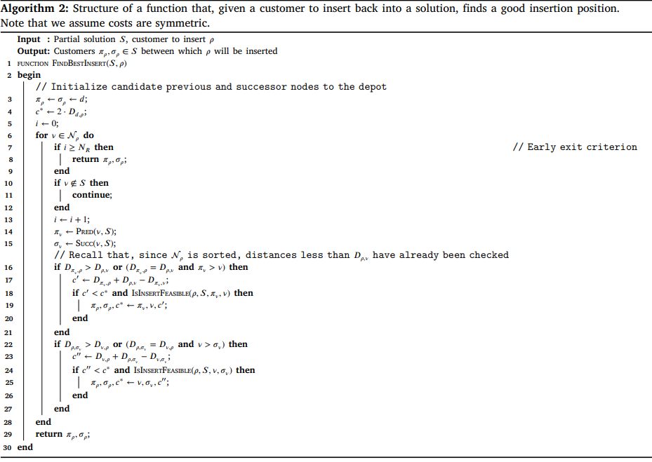
Solution Approach : FSPD Framework
Initialization: Initializes a new route from the depot to customer ρ and back to the depot.
Sets initial candidate previous and successor nodes to the depot.
Initializes the best cost to twice the distance from the depot to ρ.
Neighbor List Iteration
Gets the predecessor and successor of the neighbor in the partial solution.
Feasibility and Cost Check for Insertion Before and After Check if the insertion position before and after is feasible and provides a lower cost.
Return Best Insertion Position: Returns the best-found insertion positions after checking all neighbors or exiting early.
Src: https://doi.org/10.1016/j.tre.2024.103550
Src: https://doi.org/10.1016/j.tre.2024.103550

Slide 21
References
‌[1] F. Cavaliere, L. Accorsi, Demetrio Laganà, R. Musmanno, and D. Vigo, “An efficient heuristic for very large-scale vehicle routing problems with simultaneous pickup and delivery,”
Transportation research. Part E, Logistics and transportation review, vol. 186, pp. 103550–103550, Jun. 2024, doi: https://doi.org/10.1016/j.tre.2024.103550.
‌

Slide 22
Thank You

